Slide 1
Quality Refresher

Slide 2
Appointments
Create an appointment – By tools
Create an appointment – Manually
TC Problem Codes
SRO Task Codes
Service Protection

Slide 3
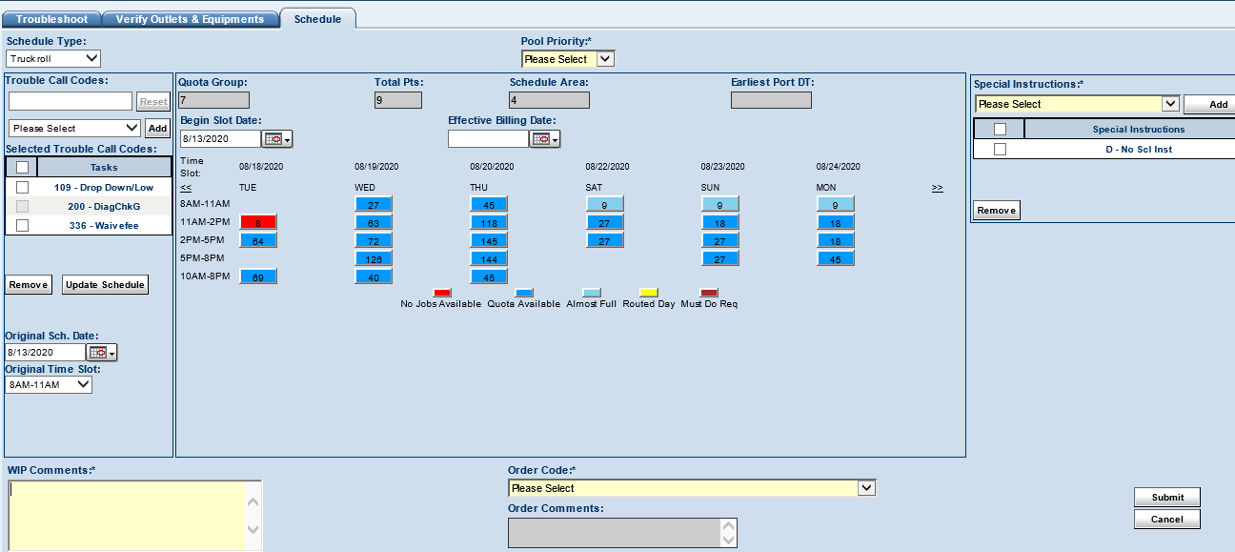
Create an appointment – By tools
After the troubleshooting process, MT and ITT take you to create the appointment automatically. Please keep in mind the account needs to be open in IDA, on the Interaction Home page and it will take you to:
Select the time slot and date.
Leave the customer’s best contact number or any comments on the WIP comments.
Click submit.

Slide 4
Create an appointment - Manually
Search for the KDB article: List of Trouble Call & SRO Codes and click on Trouble call Problem Codes.
Open the account on IDA and click on T/C.

Slide 5
Introduce the Problem Code according to the customer’s situation in Trouble Call Codes and click Add. After adding all the problem codes, click update Schedule.
Select the Time slot and Date
Click submit

Slide 6
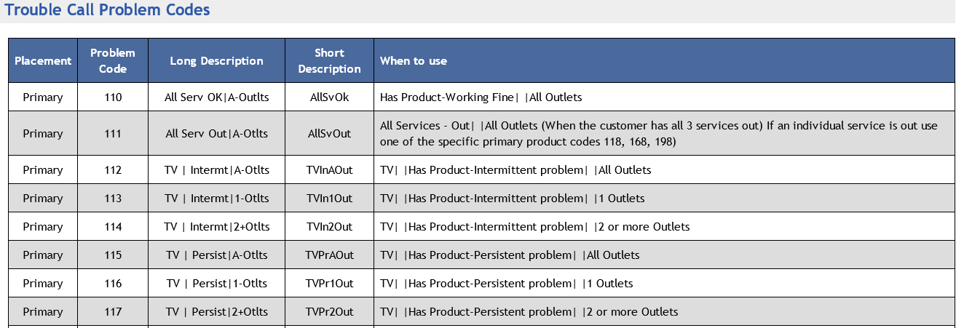
TC Problem Codes
You can find the TC codes on the KDB’s article: List of Trouble Call & SRO Codes and click on Trouble call Problem Codes. There is a description on every code to know when to use it.

Slide 7
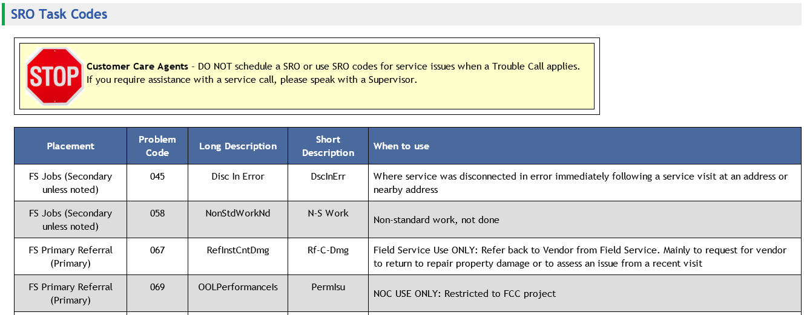
SRO Task Codes
You can find them in the same article as the TC Problem Codes “List of Trouble Call & SRO Codes”. There is a description on every code to know when to use it.

Slide 8
Service Protection Plan
Optimum's Service Protection provides customers with a worry-free experience by covering them from unexpected service visit fees. May be offered to the Account Holder and/or Authorized User and CPNI is not required to add it. For more information about Benefits and Exclusions go to KDB article: Service Protection (SP). You can add it through Modify Services located in the Quick Links of IDA.
If you sign up for Service Protection, which costs $7.99 per month, the service appointment fee will be covered for this appointment as well as any future eligible service appointments.
If yes:
As I mentioned, this program will cover all future service appointments and give you priority status in our support queue should you need to contact Customer Service. Please be advised that there may be a cancellation fee of $25 if you cancel within 6 months. Would you like to add Service Protection to your account at this time?

